Slide 1
Pizza Delivery
By: Danielle(Dani) Rodriguez, Danny Li

Slide 2
Description
Our Project is a Pizza Delivery web app
Customers can view items from our Menu and add/ remove items from their order.
After adding items a customer can view their total bill and place an order.
The Pizza Delivery Employee can view the order and deliver the order.

Slide 3

Front-End

Slide 4

Back-End

Slide 5
Business Rules
Pizza Delivery ONLY no dine in
All employees are cross trained, they can do any job(cook, delivery driver, FOH)
When a customer places an order they must specify the date and time(within the hour) they want their order delivered
An ingredient can exist w/ out being used in a menu item
The prices of the menu items will never change (we don’t need to store the cost in the orders table)
An order can not exist w/ out being associated w/ a customer
An employee can take vacations (0,many shifts)

Slide 6
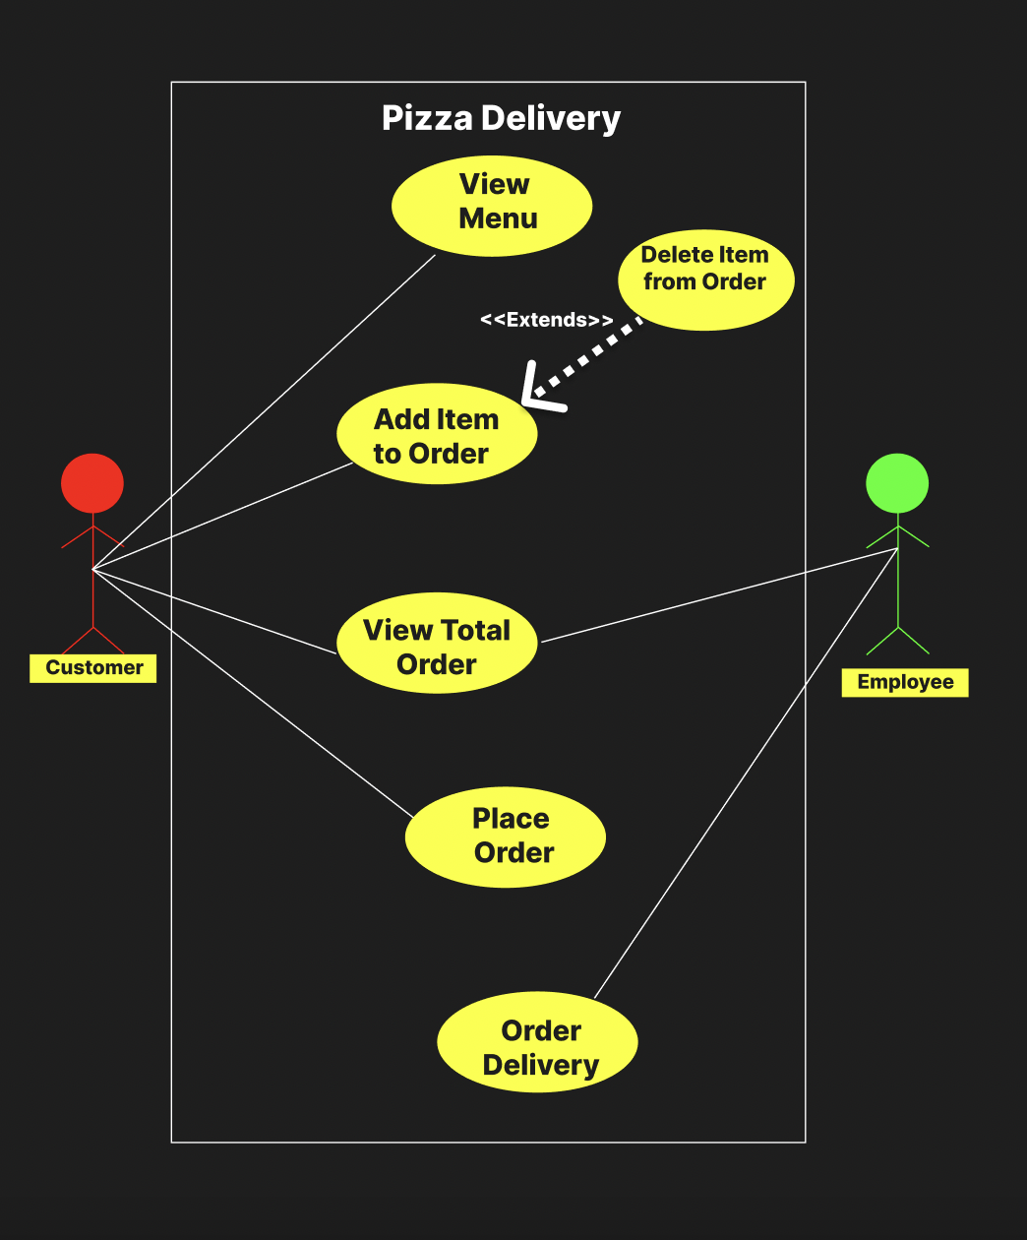
Use-Case Diagram

Slide 7
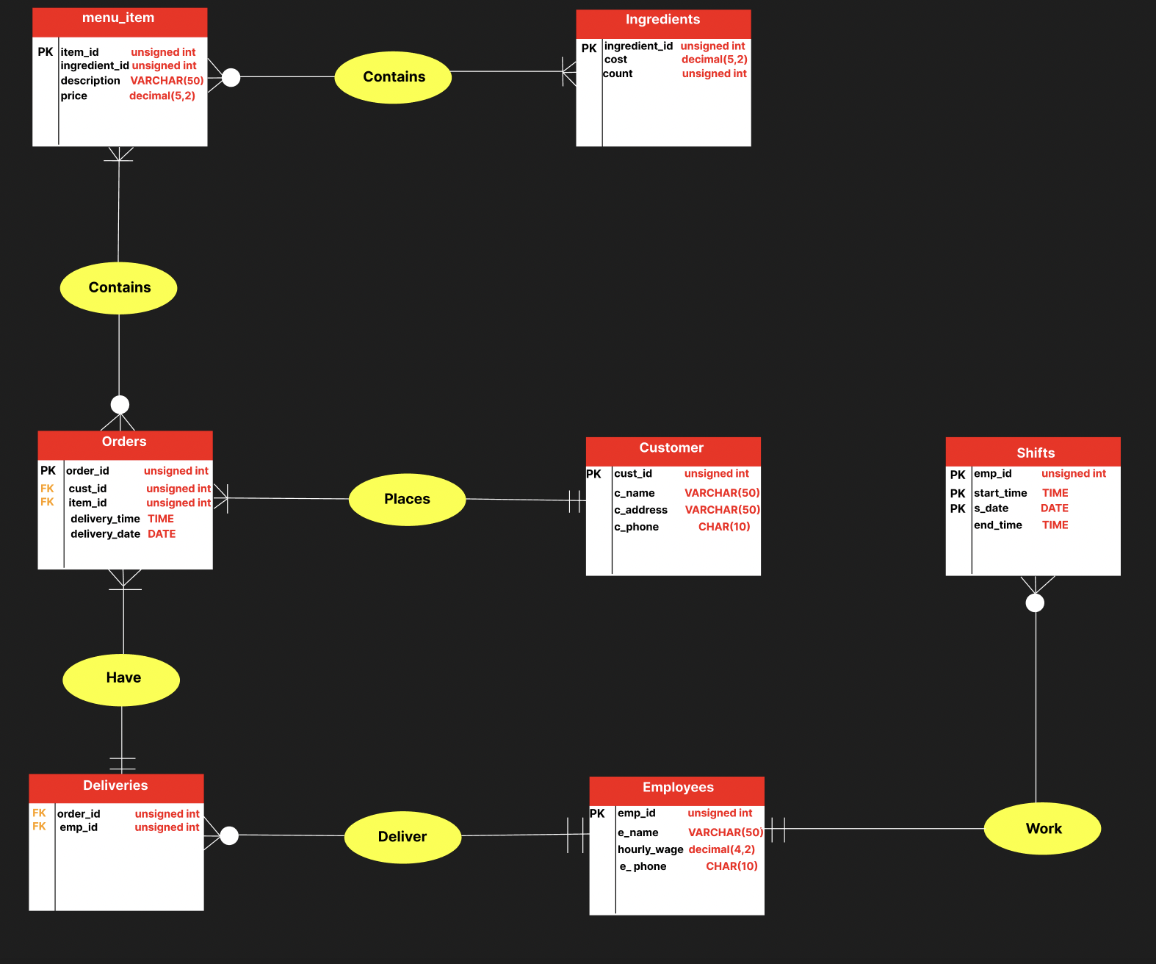
E/R Diagram &
Schema

